Slide 1
Database management systems course based project
ONLINE SHOPPING APPLICATION

Slide 3
OUR COMPANY
Mercury is the closest planet to the Sun and the smallest one in the Solar System—it’s only a bit larger than the Moon. The planet’s name has nothing to do with the liquid metal

Slide 4
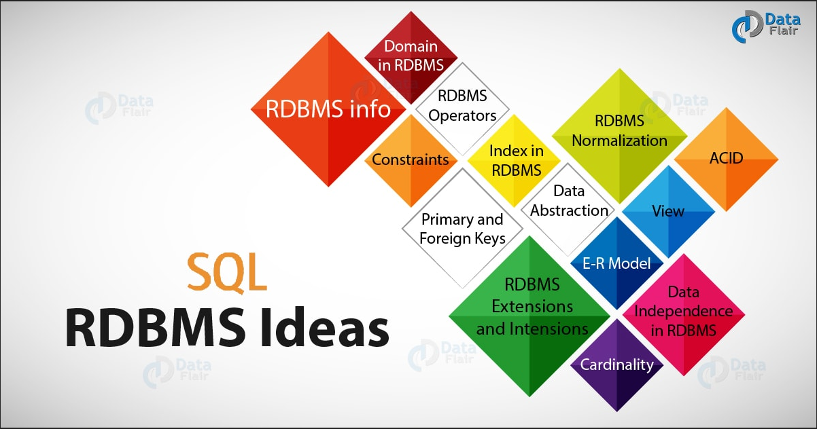
Concepts Involved in dbms

Slide 5
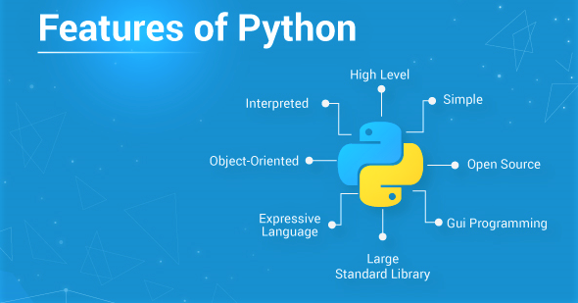
Concepts involved in python

Slide 6
ABSTRACT
The purpose of online shopping is to save time, save money. Through online shopping one can save his valuable time. One can watch and select things he wants to buy. Through online shopping we can save our money because prices are less than market prices and we receive our bought things at our home.
Our first point of discussion is the dissimilarity between shopping at stores and shopping online is time. Shopping in the stores spend more time than shopping online. A trip to the mall could take two to three hours including transportation time. You must spend many hours looking for the right products or in the lines trying to just purchase it. In addition, comparing the product against other online store competitors also takes us a lot of time. This includes drive time to the store locations, time to wait sellers bring products for us to take home and the time to check out. On the other hand, online shopping cuts out the time spent on transportation and walking from store to store. Comparing prices is faster online.
This project aims to develop an Online Shopping application for customers. The system is an online application that can be accessed by visitors if proper login details are provided.

Slide 7
TABLE OF CONTENTS
01
02
03
INTRODUCTION
ER-DIAGRAM
LITERATURE

Slide 8
TABLE OF CONTENTS
04
05
06
requirements
implementation
CONCLUSION

Slide 9
INTRODUCTION
Online shopping is a form of electronic commerce which allows consumers to directly buy goods or services from a seller over the Internet using a web browser or a mobile app.
This project aims to develop an Online Shopping application for customers. The system is an online application that can be accessed by visitors if proper login details are provided.
The project has been planned to be having a view of distributed architecture, with centralized storage of a database. The application for the storage of the data has been planned to use the constructs of Oracle 11g and all the user interfaces have been designed using the PYTHON.
Our shopping application provides a personalised and flexible shopping experience for customers . The shoppers can also view their past shopping details easily anytime.
There will be a payment organizing page in which visitors have access to a wide range of payment options for the items they are going to purchase.

Slide 10
INTRODUCTION
MAIN OBJECTIVE:-
The main motive is to develop a web application which provides an efficient way to shop online. It usually enables shoppers to use "search" features to find specific models, brands or items. The application consists of a wide variety of products which a customer can compare and select the best from. Later these selected products can either be wish listed or added to the cart. Once the customer has figured out his needs, he can proceed through a valid method of payment in order to complete a transaction, such as a credit card, an Interac-enabled debit card, cash-on-delivery, or a service such as PayPal. Finally, he can wait for a couple of days for his ordered to be delivered at his doorstep.

Slide 11
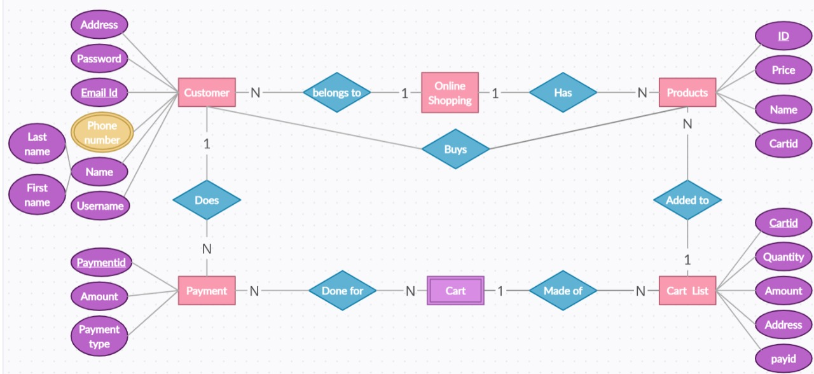
Er-Diagram

Slide 12
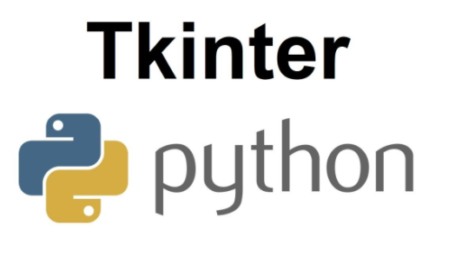
literature
TKINTER − Tkinter is the Python interface to the Tk GUI toolkit shipped with Python.
Python offers multiple options for developing GUI (Graphical User Interface). Out of all the GUI methods, tkinter is the most used method. It is a standard Python interface to the Tk GUI toolkit shipped with Python. Python with tkinter is the fastest and easiest way to create the GUI applications. Creating a GUI using tkinter is an easy task.
To create a tkinter app:-
Importing the module – tkinter.
Create the main window (container).
Add any number of widgets to the main window.
Apply the event Trigger on the widgets.

Slide 13
WIDGETS:-
Widgets are similar in spirit to elements in HTML. You will find different types of widgets for different types of elements in the Tkinter. They are standard GUI elements and provide the user with controls like buttons, text, menus, and text boxes.
Button : Button widget has a property for switching on/off. When a user clicks the button, an event is triggered in the Tkinter.
Canvas : Canvas is used to draw shapes in your GUI and supports various drawing methods.
Checkbutton : Checkbutton records on-off or true-false state. It lets you can select more than one option at a time and even leave it unchecked.
Entry : Entry widget is used to create input fields or to get input text from the user within the GUI.
Frame : Frame is used as containers in the Tkinter for grouping and adequately organizing the widgets
Label : Label is used to create a single line widget like text, images, etc.

Slide 14
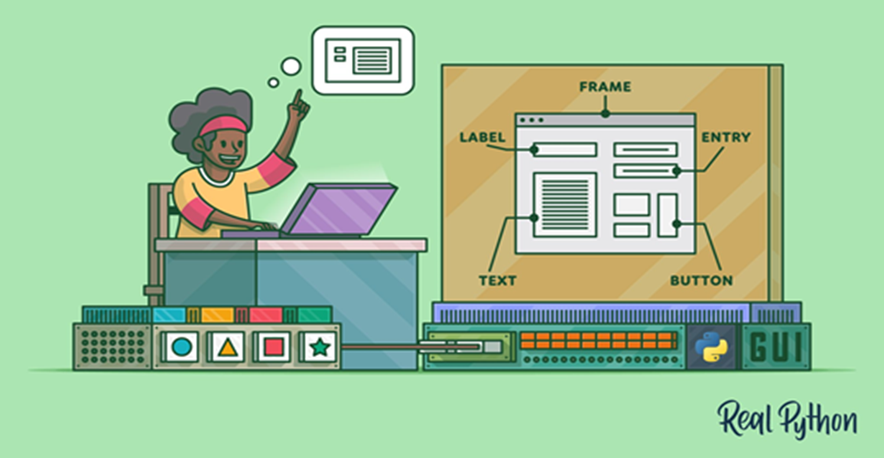
Tkinter-widgets

Slide 15
Sql database
SQL is a domain-specific language used in programming and designed for managing data held in a relational database management system (RDBMS), or for stream processing in a relational data stream management system (RDSMS). It is particularly useful in handling structured data, i.e., data incorporating relations among entities and variables.
The SQL language is subdivided into several language elements, including:
Clauses, which are constituent components of statements and queries.
Expressions, which can produce either scalar values, or tables consisting of columns and rows of data.
Predicates, which specify conditions that can be evaluated to SQL three-valued logic (3VL) (true/false/unknown) or Boolean truth values and are used to limit the effects of statements and queries, or to change program flow.
Queries, which retrieve the data based on specific criteria. This is an important element of SQL.
Statements, which may have a persistent effect on schemata and data, or may control transactions, program flow, connections, sessions, or diagnostics.

Slide 16
Oracle 11g
Oracle Database 11g delivers industry leading performance, scalability, security and reliability on a choice of clustered or single-servers running Windows, Linux, and UNIX. It provides comprehensive features to easily manage the most demanding transaction processing, business intelligence, and content management applications.
The system is built around a relational database framework in which data objects may be directly accessed by users (or an application front end) through structured query language (SQL). Oracle is a fully scalable relational database architecture and is often used by global enterprises, which manage and process data across wide and local area networks. The Oracle database has its own network component to allow communications across networks. It is a database commonly used for running online transaction processing (OLTP), data warehousing (DW) and mixed (OLTP & DW) database workloads.

Slide 17
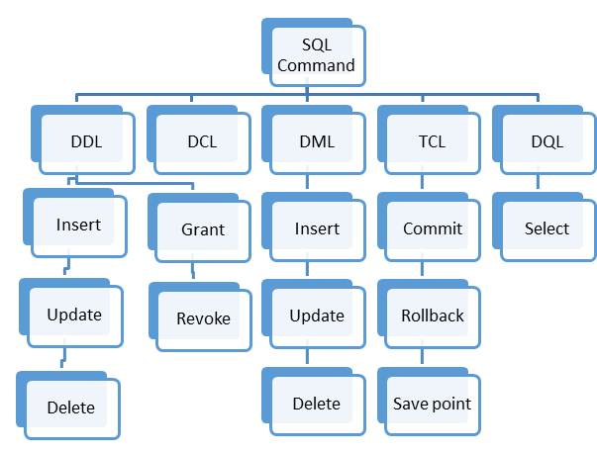
Frequently used sql commands
SELECT - extracts data from a database
UPDATE - updates data in a database
DELETE - deletes data from a database
INSERT INTO - inserts new data into a database
CREATE DATABASE - creates a new database
ALTER DATABASE - modifies a database
CREATE TABLE - creates a new table
ALTER TABLE - modifies a table
DROP TABLE - deletes a table
CREATE INDEX - creates an index (search key)
DROP INDEX - deletes an index

Slide 18
Python
Python is an interpreted, object-oriented, high-level programming language with dynamic semantics. Its high-level built-in data structures, combined with dynamic typing and dynamic binding, make it very attractive for Rapid Application Development, as well as for use as a scripting or glue language to connect existing components together. Python's simple, easy to learn syntax emphasizes readability and therefore reduces the cost of program maintenance. Python supports modules and packages, which encourages program modularity and code reuse. The Python interpreter and the extensive standard library are available in source or binary form without charge for all major platforms and can be freely distributed.
Python works on different platforms (Windows, Mac, Linux, Raspberry Pi, etc.).
It runs on an interpreter system, meaning that code can be executed as soon as it is written. This means that prototyping can be very quick.

Slide 19
SQLite3
This section shows you how the SQLite database functions work using Python programming language.
Python provides two popular interfaces for working with the SQLite database library: PySQLite and APSW. Each interface targets a set of different needs.
SQLite3 can be integrated with Python using sqlite3 module, which was written by Gerhard Haring. It provides an SQL interface compliant with the DB-API 2.0 specification described by PEP 249. You do not need to install this module separately because it is shipped by default along with Python version 2.5.x onwards.
To use sqlite3 module, you must first create a connection object that represents the database and then optionally you can create a cursor object, which will help you in executing all the SQL statements.

Slide 20
Python sqlite3 module APIs
Following are important sqlite3 module routines, which can suffice your requirement to work with SQLite database from your Python program. If you are looking for a more sophisticated application, then you can investigate Python sqlite3 module's official documentation.
sqlite3.connect(database [,timeout ,other optional arguments]) : This API opens a connection to the SQLite database file. You can use ":memory:" to open a database connection to a database that resides in RAM instead of on disk. If database is opened successfully, it returns a connection object.
connection.cursor([cursorClass]) : This routine creates a cursor which will be used throughout of your database programming with Python. This method accepts a single optional parameter cursorClass. If supplied, this must be a custom cursor class that extends sqlite3.Cursor.

Slide 21
cursor.execute(sql , [optional parameters]) : This routine executes an SQL statement. The SQL statement may be parameterized (i. e. placeholders instead of SQL literals). The sqlite3 module supports two kinds of placeholders: question marks and named placeholders (named style).
connection.commit() : This method commits the current transaction. If you don't call this method, anything you did since the last call to commit() is not visible from other database connections.
cursor.fetchone() : This method fetches the next row of a query result set, returning a single sequence, or None when no more data is available.
cursor.fetchall() : These routine fetches all (remaining) rows of a query result, returning a list. An empty list is returned when no rows are available.

Slide 22
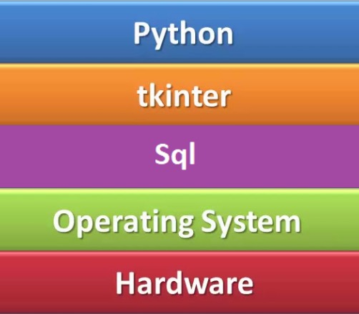
requirements
System requirements are the required specifications a device must have in order to use certain hardware or software. For example, a computer may require a specific I/O port to work with a peripheral device. A smartphone may need a specific operating system to run a particular app. It encompasses those tasks that go into determining the needs or conditions to meet for a project.
SOFTWARE REQUIREMENTS:-
Python version 3.4 or above.
Tkinter
Functools
SQLite3
Datetime
Pandas
2. Operating systems
3. Oracle 11g database

Slide 23
requirements
The most common set of requirements defined by any operating system or software application is the physical computer resources, also known as hardware, A hardware requirements list is often accompanied by a hardware compatibility list (HCL), especially in case of operating systems.
HARDWARE REQUIREMENTS:-
Minimum requirements:
CPU : Intel Duo Core
RAM: 2gb
STORAGE : 16gb
OS : Windows Xp, Windows Vista, Windows 7/8/8.1/10, Mac OS X 10.11, Mac OS 10.12/10.13/10.14
11, Any Linux – Ubuntu, Kali.

Slide 24
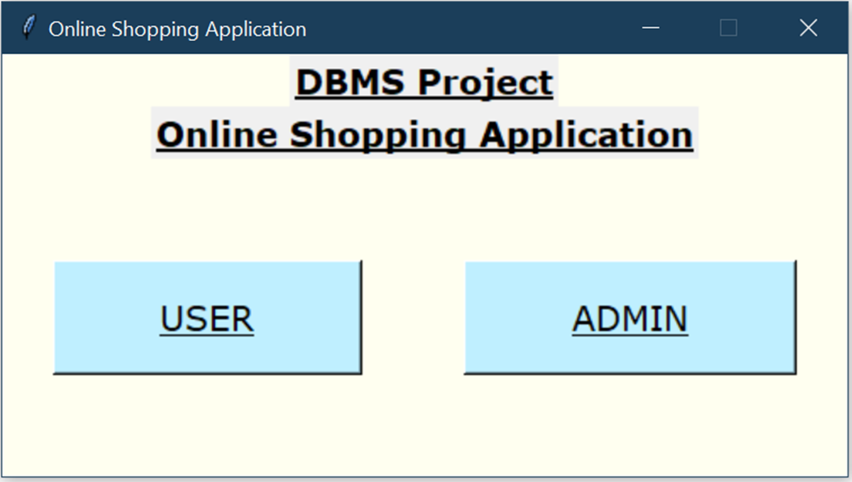
Model implementation
Home Window
It is a window which helps in navigation to the respective
Preference based on the user requirement.
The window displays two buttons namely
- USER
When we click on this button you would be navigated to
the login page and asked for your credentials.
- ADMIN
When we click on this button it navigates us to the admin
page where the user details will be displayed.

Slide 25
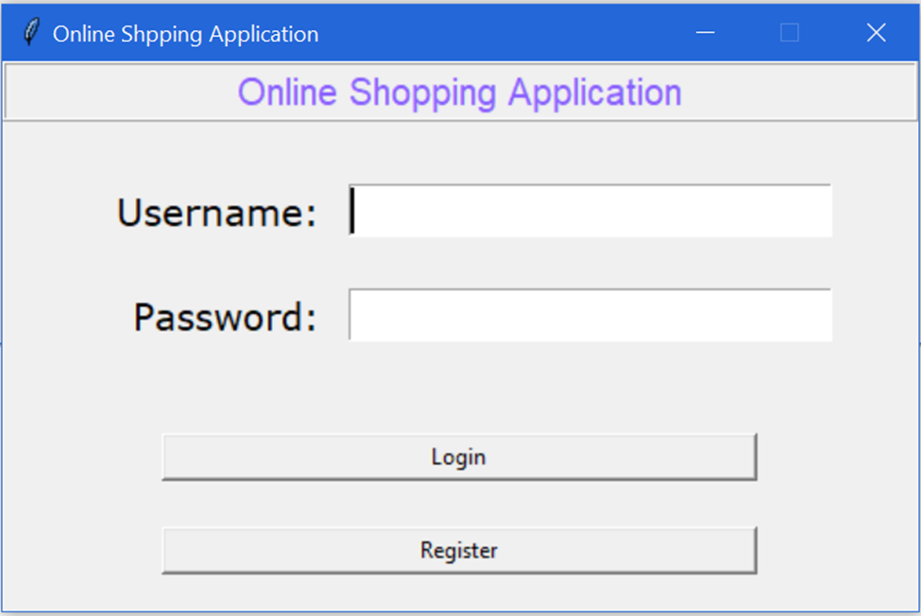
USER LOGIN PAGE
If the user is already an account holder, he can just login
giving his user credentials and press login.
If he doesn’t have an account, he can just register to create a new account by pressing the register button.
If the credentials entered by the user are wrong, an error message will be popped out indicating the wrong entry of either username or password.

Slide 26
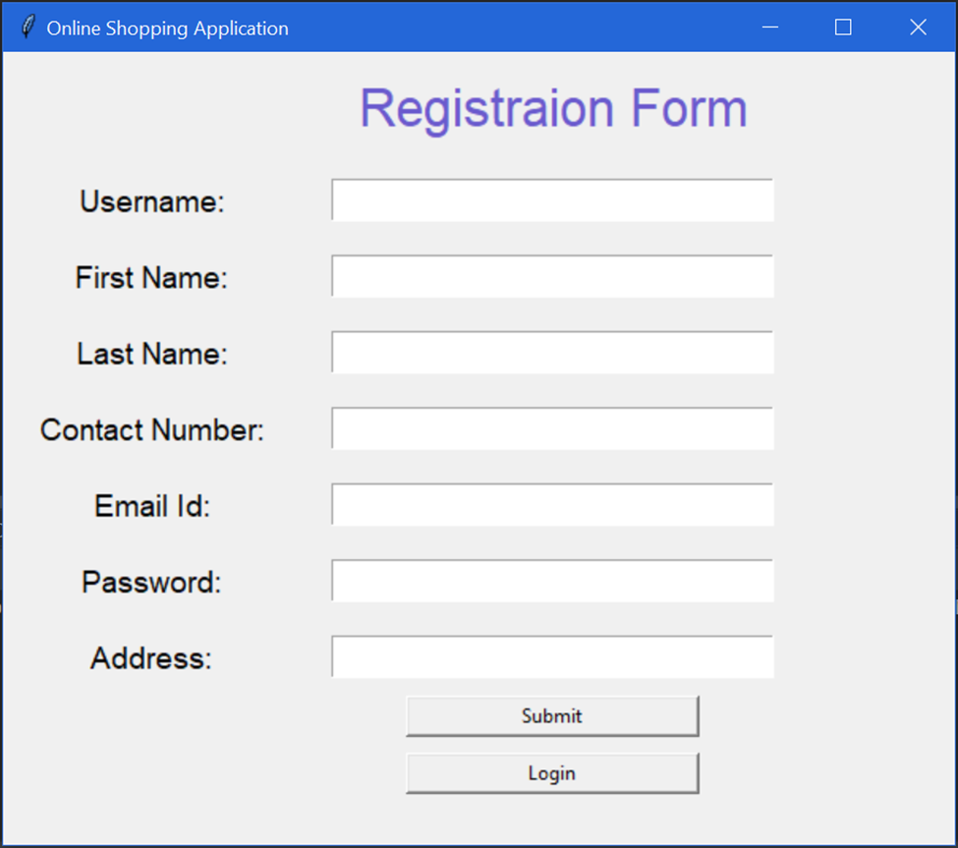
REGISTRATION FORM
A registration form is a list of fields that a user will input data into and submit to a company or individual.
New users can create an account using this registration form.
The users are required to enter his username, first name, contact number, email id, password and address to register.
Username is a unique value which doesn’t allow any duplicates.
The user can press submit and he can login to his account.

Slide 27
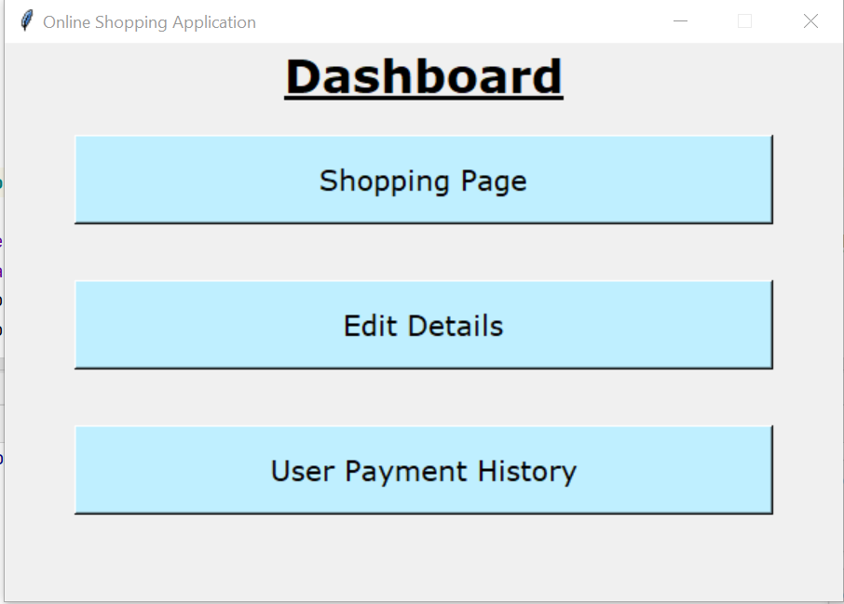
DASHBOARD
Once the user gets successfully logged in, he will be navigated to the opening page which contains three buttons namely:
Shopping Page : It contains a list of items that the user can purchase.
Edit Details : If the user wanted to edit his details, he can just click on this button.
User Payment History : This button lets the user know about all the previous transactions he made.

Slide 28
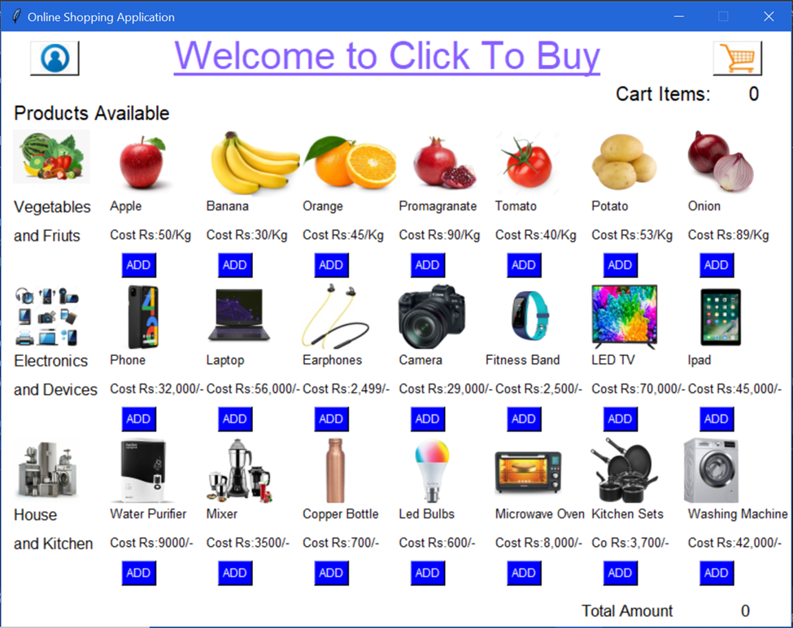
SHOPPING PAGE:
This page consists of the product details divided in their respective categories.
The categories contain
Vegetables and fruits.
Electronics and Devices.
House and Kitchen
The user can click on add right below the product to add the item into their shopping cart.
The profile and cart can also be accessed the logos on the top ends.
The total amount of all the items is calculated at the right bottom.

Slide 29
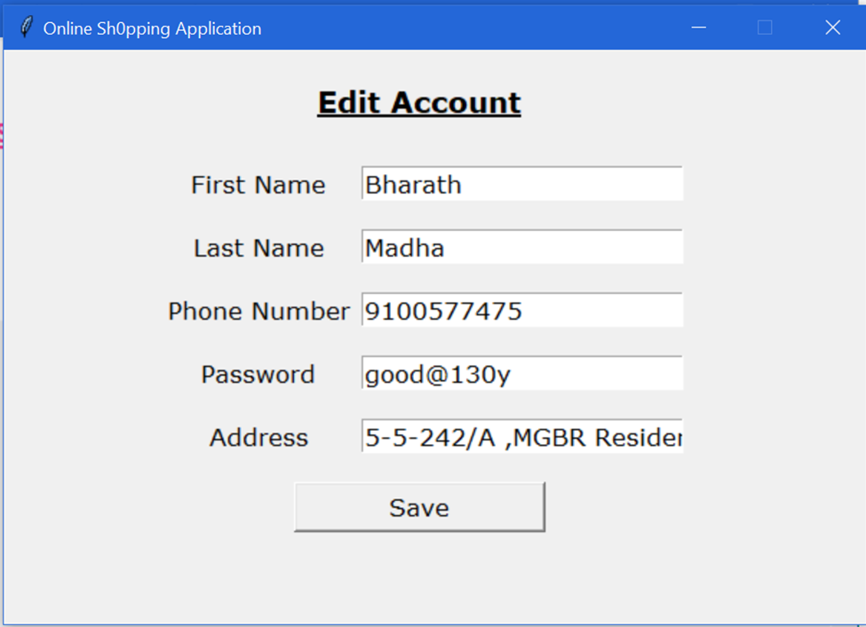
EDIT ACCOUNT:
The user can also edit his account once he logged in successfully.
The user can edit his first name, last name,
Phone number, password and his address.
Once the user is satisfied with his modifications, he can just click on save to save the changes made.

Slide 30
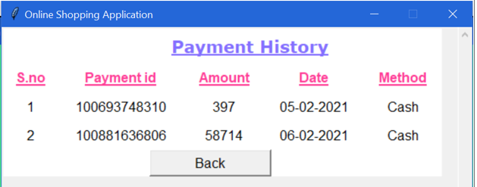
PAYMENT HISTORY:
This window consists of all the payments made by the user in his past.
It maintains the records of payment id, amount, date and the method of payment.
The Back button below allows the user to navigate to the previous page.

Slide 31
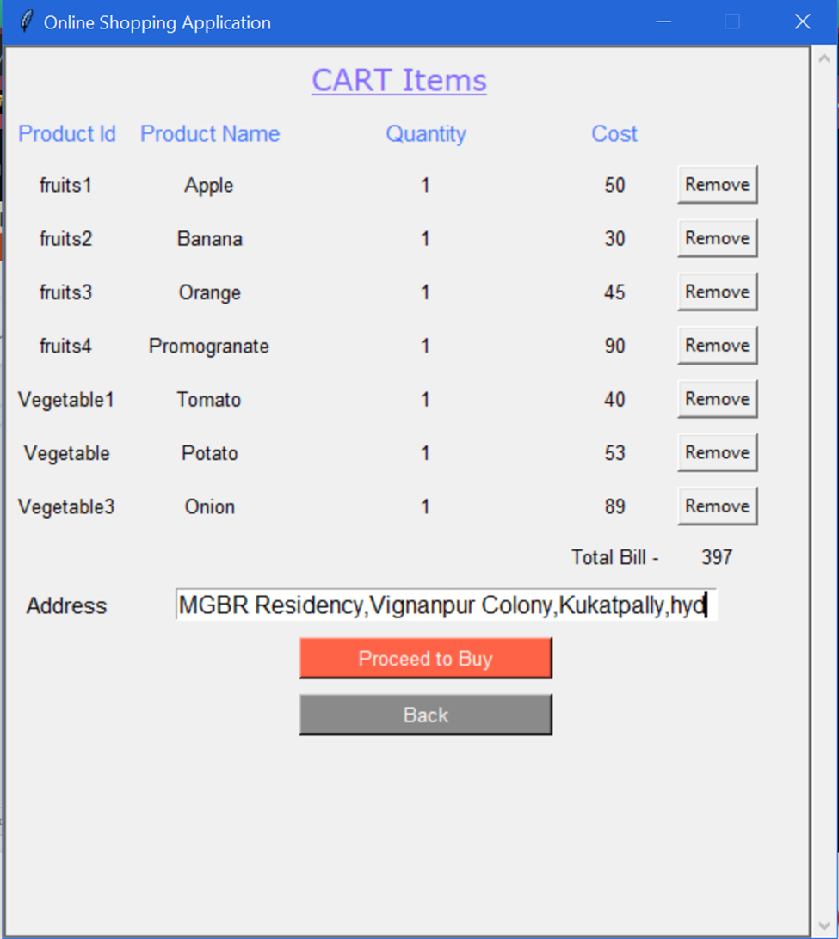
CART ITEMS:
All the products added to the cart by the user are displayed here.
If the user wanted to remove any item, he can just press the remove button adjacent to the product details.
The user can finally enter his address where the products are to be delivered.
Then he can proceed to buy or press back if he wanted to add anymore items to his cart.

Slide 32
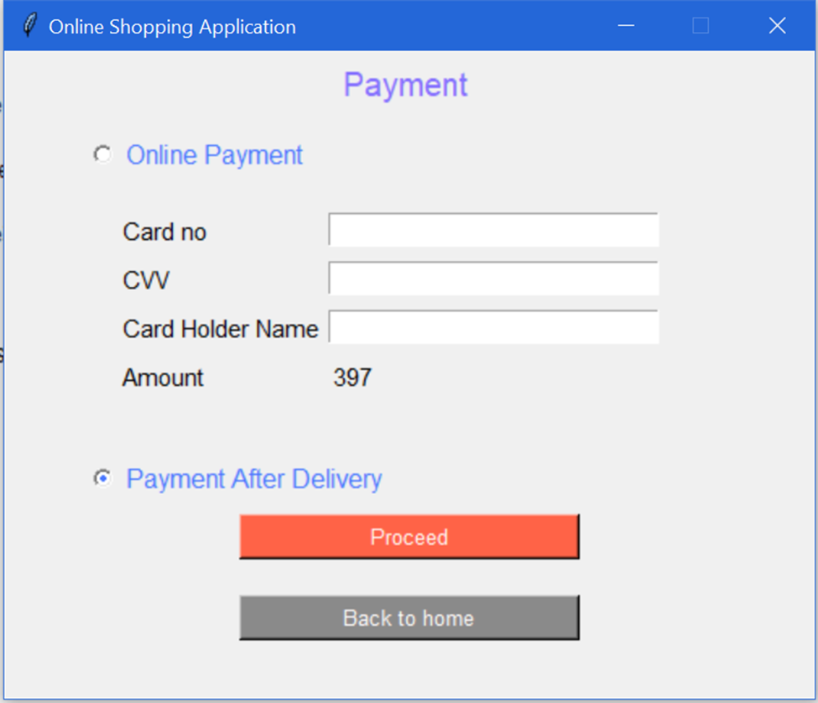
PAYMENT:
The user can either pay through online or through cash-on-delivery.
Online payment involves card number, cvv, card holder name and the amount are displayed.
Once the user is decided with his mode of payment, he can proceed or if he wanted any change in the details, he can press back to home.

Slide 33
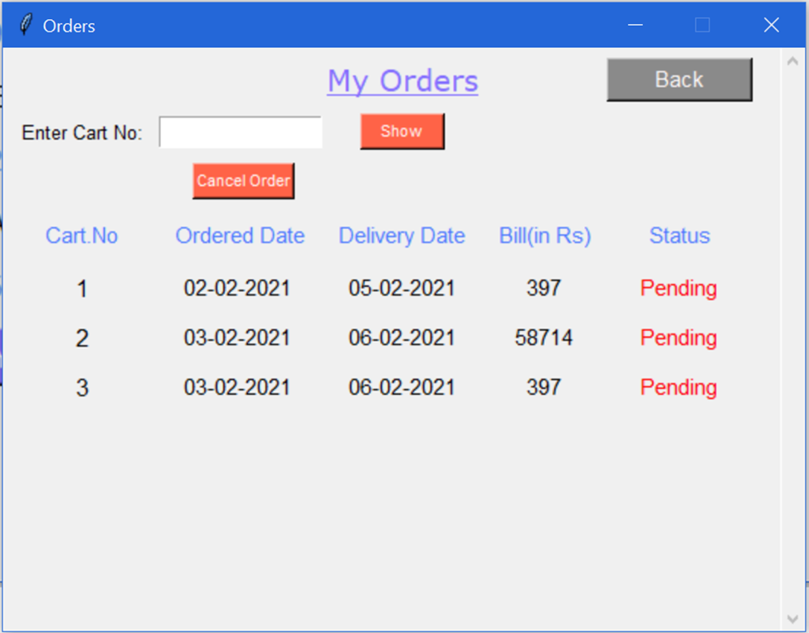
ORDER SUMMARY:
Finally, all the items ordered along with their expected delivery dates are presented to the user.
The customer can expect his delivery within 3 days from the ordered date.
If the customer wanted to cancel his order, he can just cancel it by pressing the cancel order button.

Slide 34
CONCLUSION
The main motive is to develop a desktop application which provides an efficient way to shop online. It usually enables shoppers to use "search" features to find specific models, brands or items. The application consists of a wide variety of products which a customer can compare and select the best from. Later these selected products can either be wish listed or added to the cart. Once the customer has figured out his needs, he can proceed through a valid method of payment in order to complete a transaction, such as a credit card, an Interac-enabled debit card, cash-on-delivery, or a service such as PayPal. Finally, he can wait for a couple of days for his ordered to be delivered at his doorstep.

